Slide 1
Solving similar triangle problems.
L.O. Use the concept of similar triangles to solve mathematical problems.

Slide 2
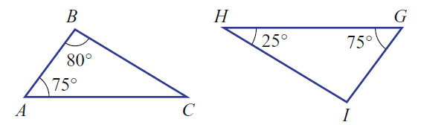
From last lesson;
can you write a proof that shows why we know these 2 triangles are similar?

Slide 3
Similarity
Similar triangles are triangles having the same shape but different size.
When we try and solve problems with similar triangles it is important to remember.;
1. All three sets of angles are the same on both triangles.
2. All three sets of sides have the same scale factor.

Slide 4


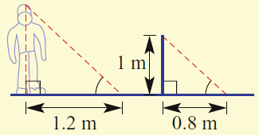



Proofs
EQ – How do we solve problems using similarity?
Step 1. Read the question carefully.
Step 2. Draw a picture
Step 3. Write all known angle sizes and lengths onto the triangle
Step 4. Find corresponding sides to find the scale factor.
Step 4. Use your scale factor to find any missing sides .

Slide 5

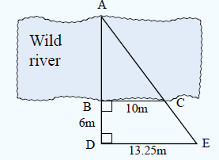
We do.

Slide 6

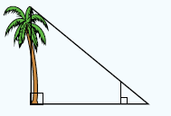
We do.

Slide 7
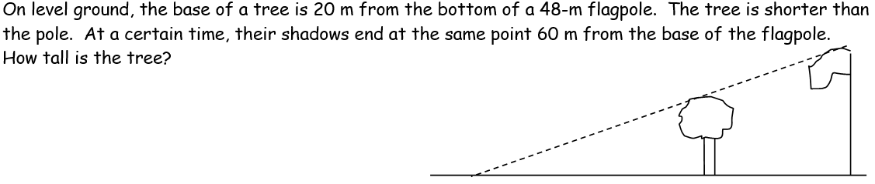
Your turn

Slide 8
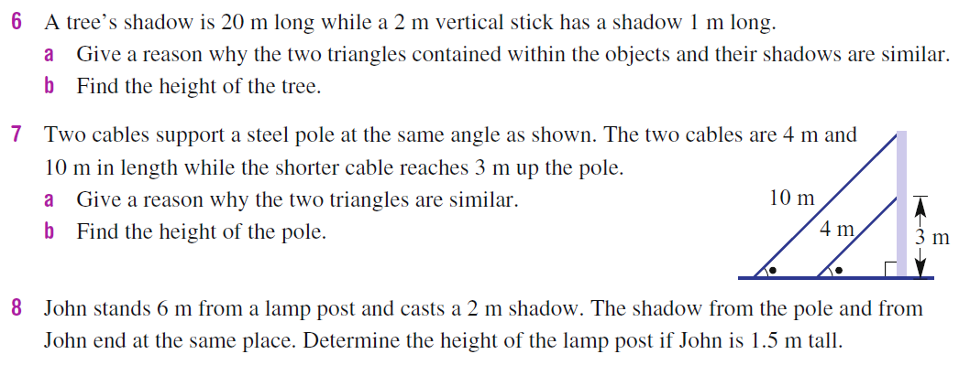
Complete questions 6 – 11 from ex 7H, 433 Yr 9 Essentials book

Slide 9
